Slide 1

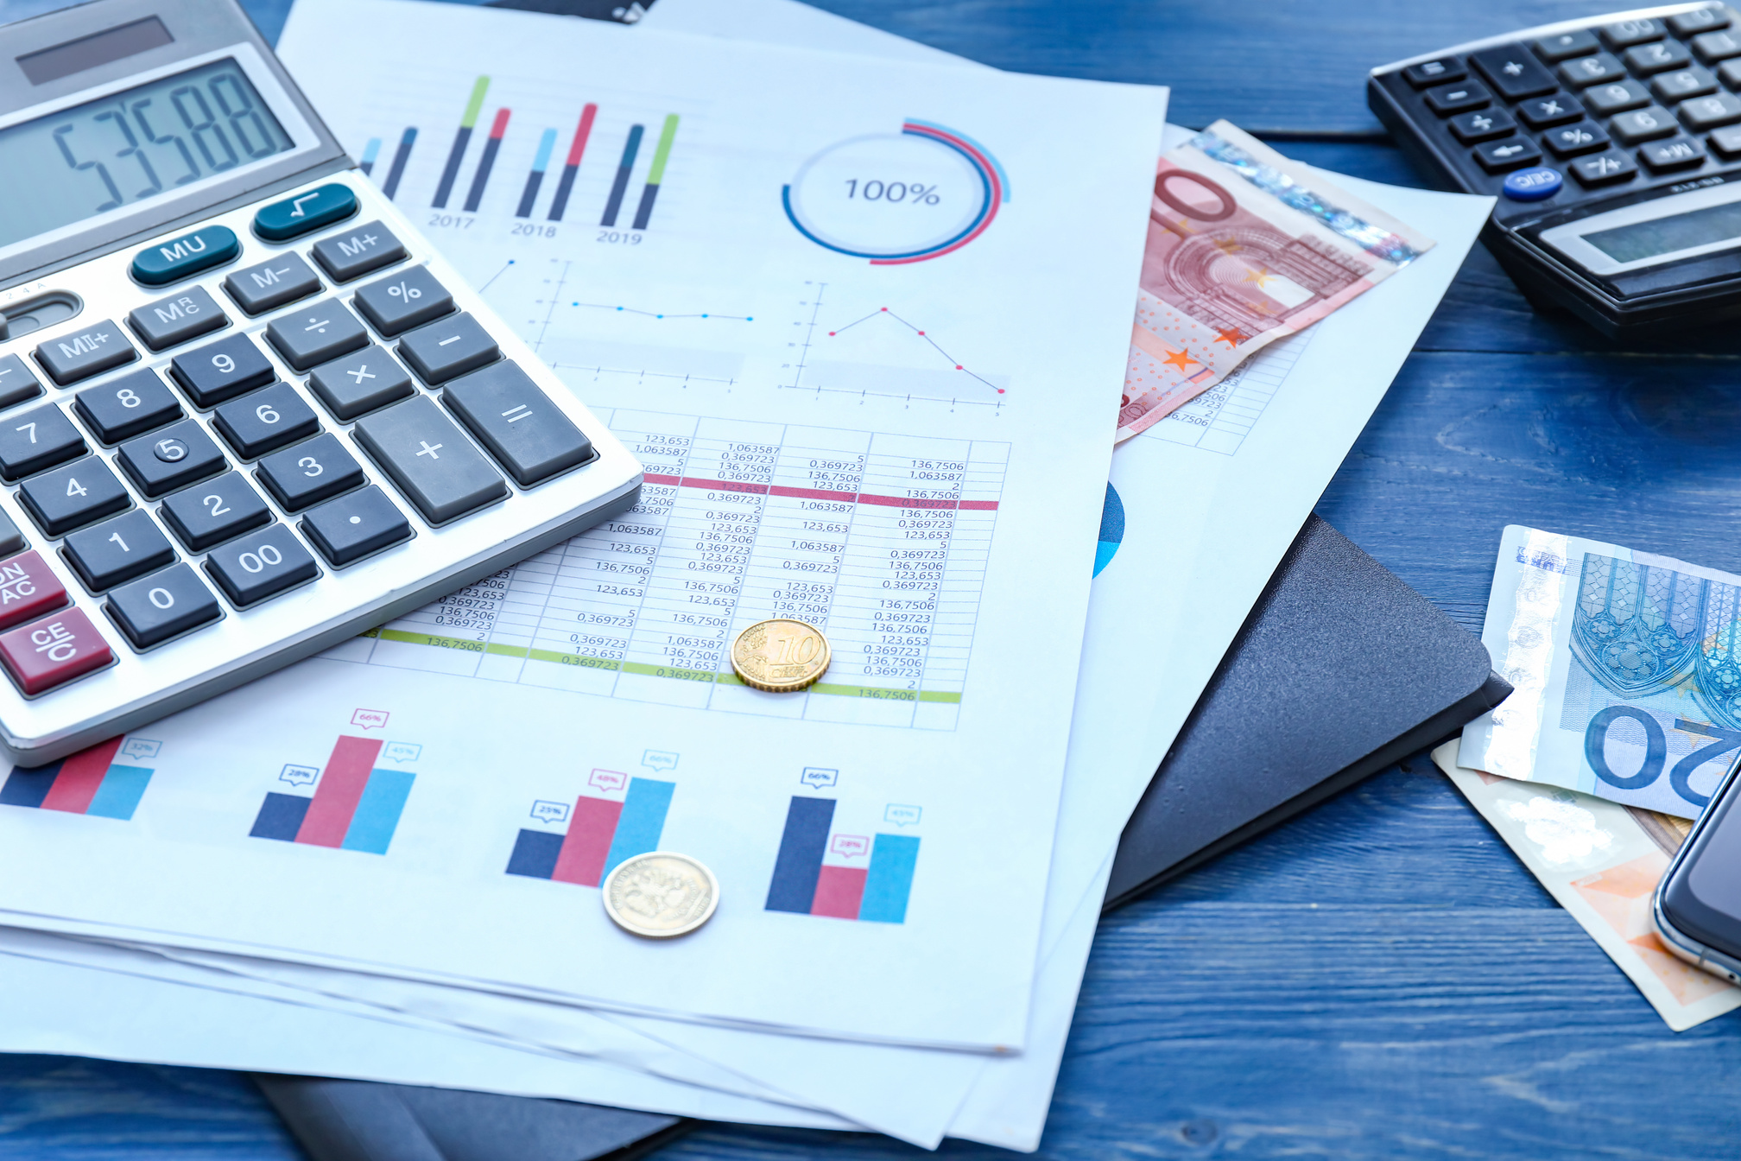

STOCK MARKET PORTFOLIO ALLOCATION AND RISK MANAGEMENT USING REINFORCEMENT LEARNING
An end-to-end reinforcement learning system for intelligent investment decisions and risk control

Slide 2
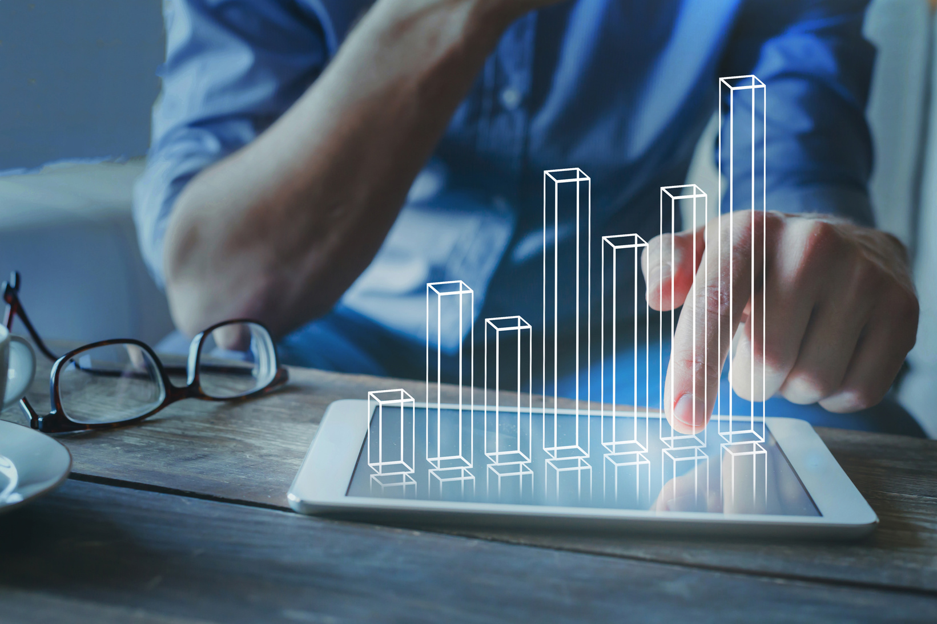

OVERVIEW
AI-powered investment assistant designed to help beginner investors to easily input investment amount, select a risk profile (Low, Medium, High) along with the investment period and run a personalized portfolio simulation with clear visual summaries and recommendations with added reason —all without needing financial or technical expertise.
01
Trained using DDPG for continuous portfolio allocation and risk management.
02
Uses historical stock data from Yahoo Finance via a custom Gym environment.
03
ipywidget UI for interaction

Slide 3

REAL-WORLD PROBLEMS
Despite the growing popularity of retail investing, most beginner traders struggle to achieve consistent returns.
UNDER-PERFORMANCE
INADEQUATE RISK MANAGEMENT
TIME AND KNOWLEDGE CONSTRAINTS
Over 75% of retail traders lose money annually due to ineffective portfolio strategies and lack of diversification
Many traders fail to incorporate dynamic risk-adjusted strategies, resulting in overexposure to volatile assets.
Retail traders often lack the expertise and time to make data-driven decisions, especially in fast-changing market conditions

Slide 4



OPPORTUNITIES AND TARGET AUDIENCE
The online trading market is rapidly growing, driven by younger investors, with over 60% of retail traders seeking advanced tools for personalized portfolio management and risk control.
Tech-Savvy Millennials and Gen Z
Retail Traders
Part-Time Traders

Slide 5


IMPLEMENTED FEATURES
01
Risk Profile Selection: Choose Low, Medium, or High risk levels.
Smart Scheduling: Get stock recommendations with projected buy/sell/hold dates.
04
02
Strategic Budget Use: Plan how much to invest
05
Automated Planning: Streamlined investing for users with limited expertise.
Personalized Allocations: Align investments with your goals(investment period) and risk appetite.
03
Visualizations: Provides visualizations to show the projected profit or loss of the invested stocks over time.
06

Slide 6


WORKFLOW
Backtesting & Evaluation:
Simulate the trading strategy on unseen data to evaluate performance.
Data Collection & Preprocessing:
Collect stock data using Yahoo Finance API.
Preprocess and batch the data for training.
UI
Display real-time stock portfolio management recommendations using Streamlit UI.
Model Training & Environment:
Implement Gym-based PortfolioTradingEnv for reinforcement learning.
Train the model using DDPG from Stable-Baselines3 and did hyper parameter tuning.

